Slide 1
CZ2002 ASSIGNMENT VIDEO
Lab Group – FSP6
Members:
Soh Yan Quan, Kenneth
Kang Wei Bin
Francis Lim Yong Wen
Koh Tat You @ Arthur Koh
Lim Shi Hao

Slide 2

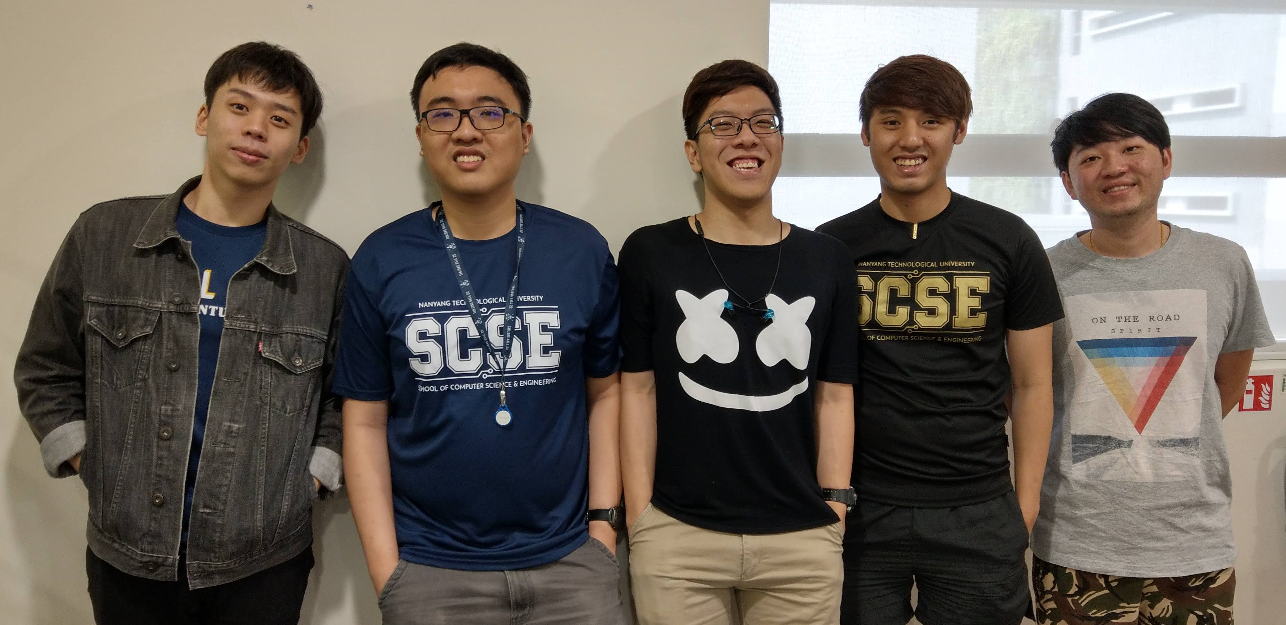

Group photo
Kenneth Soh
Francis Lim
(also voiceover for video)
Kang Wei Bin
Arthur Koh
Lim Shi Hao

Slide 3


Restaurant Reservation and Point of Sales System (RRPSS)
Enjoy!

